Slide 1

Churn Analysis of XYZ Bank Clients
Consulting Proposal
Manuk Mikayelyan
February 19 , 2023

Slide 2
Overview and Business Problem
Methodology
XYZ Bank hired consultants to analyze churn flow and recommend ways to mitigate the increasing number of customers leaving its credit card services
Customer data of the bank is used for the analysis -
10127 unique client information
23 features
Data was cleaned to fix missing, corrupted, incorrectly formatted, or incomplete entries
Performed Distribution and Cross-Correlation Analysis to identify impactful columns as insights for the business use case.

Slide 3
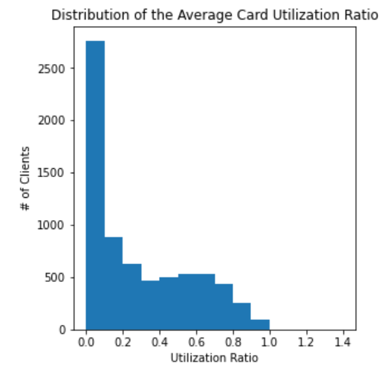
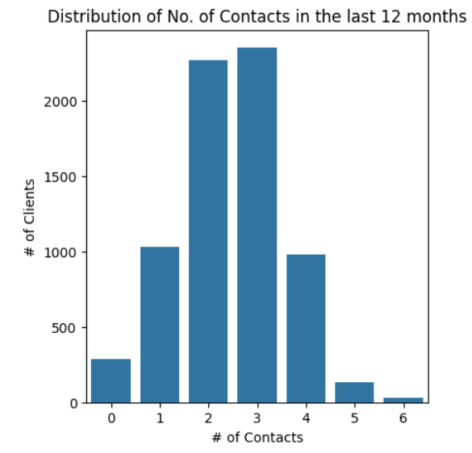
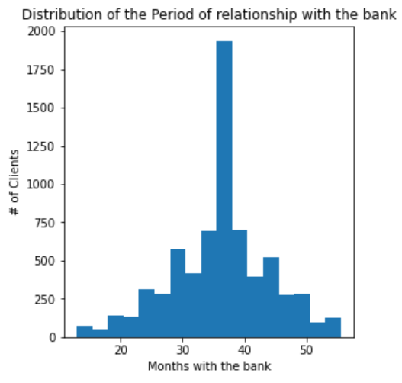
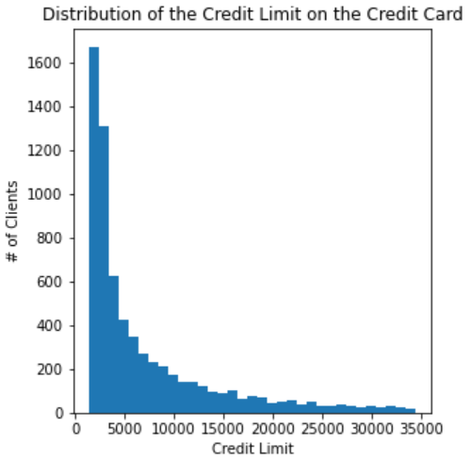
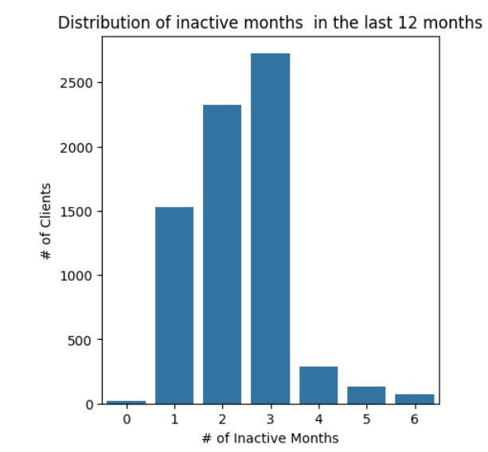
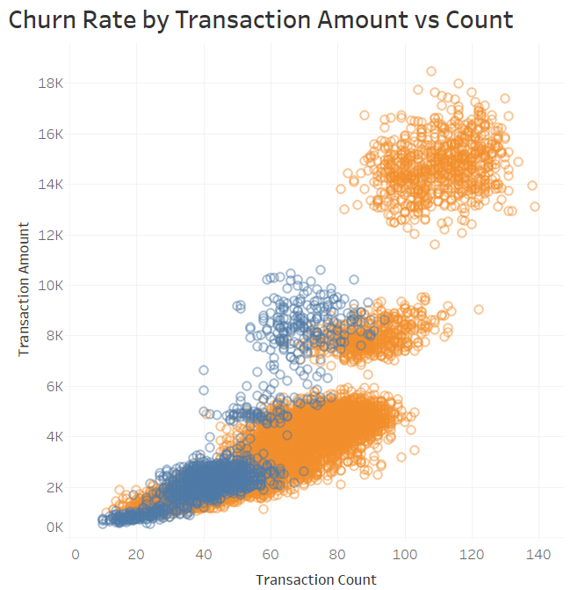
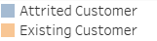
Understanding the market
Most of the customers have a utilization rate of less the 10%
Customers usually have 2-3 contacts with the bank
Most customers have a relationship of 35 months with the bank
Most customers have a credit limit of less than 5K
Customers were inactive for 1-3 months in the last 12 months, on average
Positive correlation when Trns. Amt < 6K
Attrited customers - max Trns. Amt. < 11K, and Trans. Cnt. < 95

Slide 4
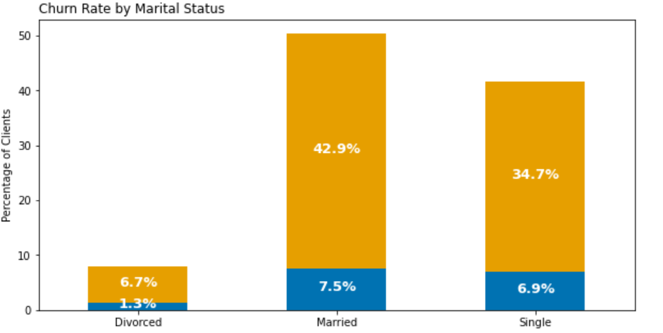
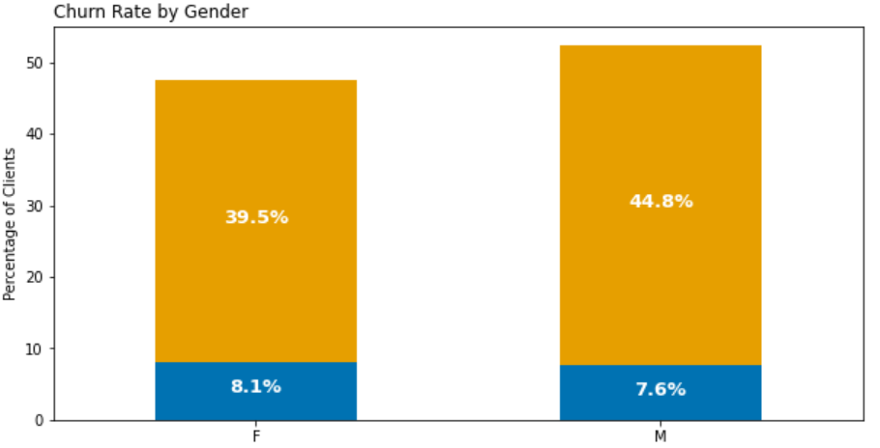
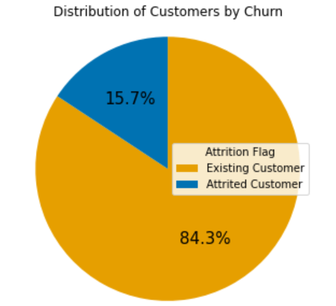
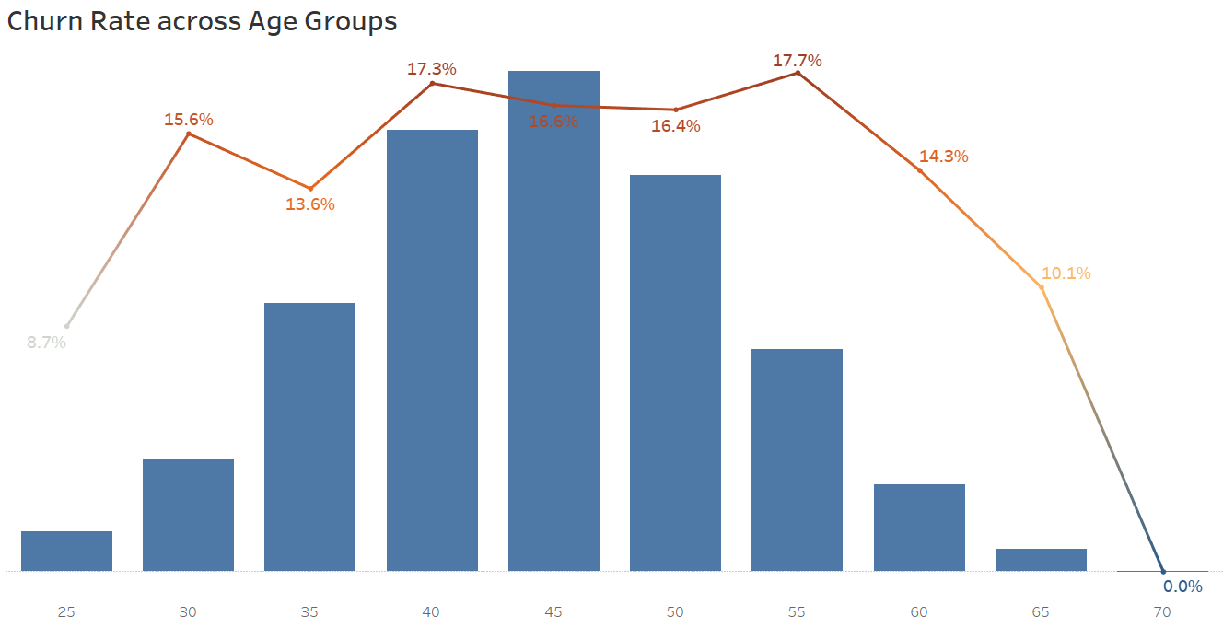
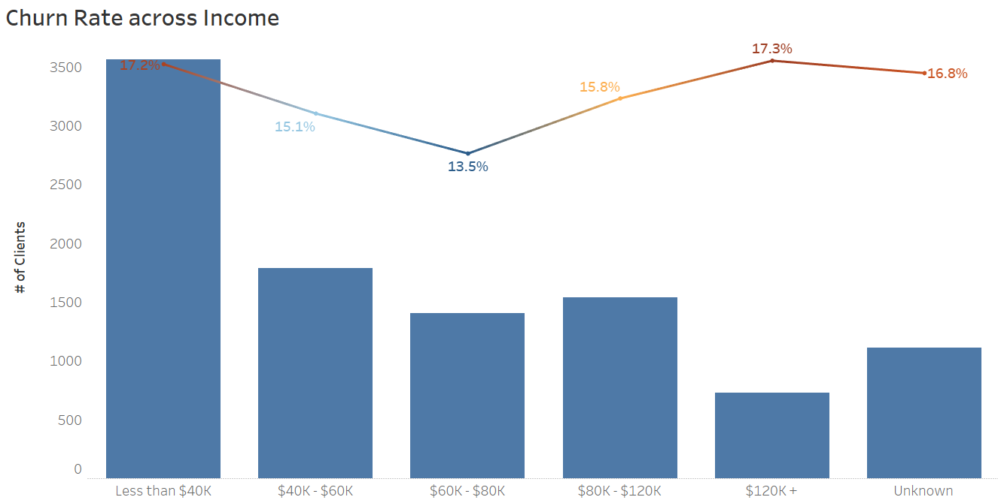
Churn by Customer Demographics
Churn ca. 16%
Churn is more likely among customers
aged 50-55
earning less than 40K or greater than 120K

Slide 5
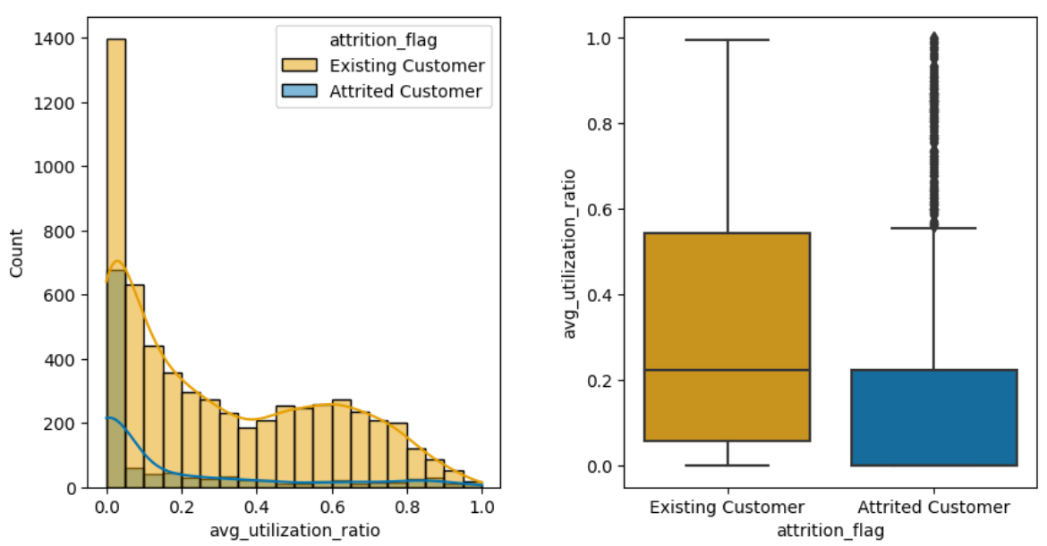
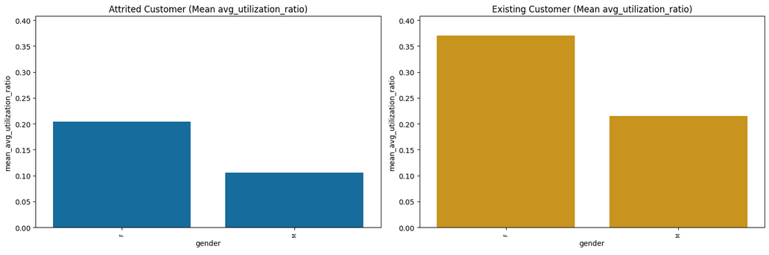
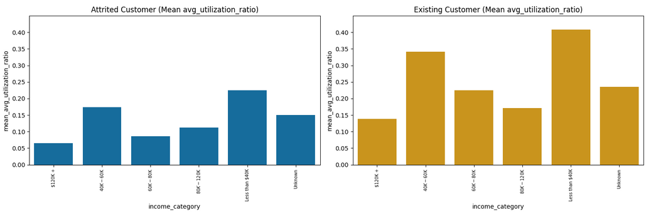
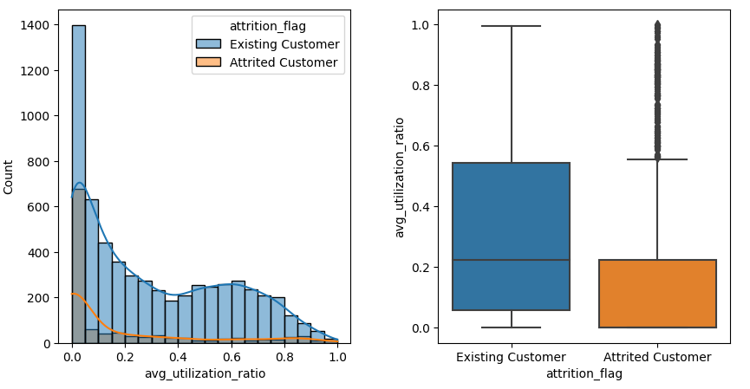
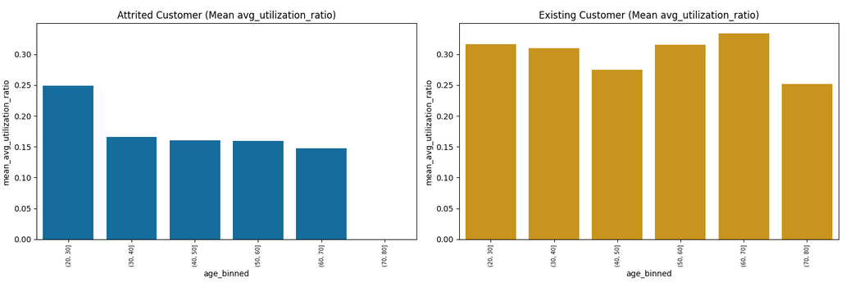
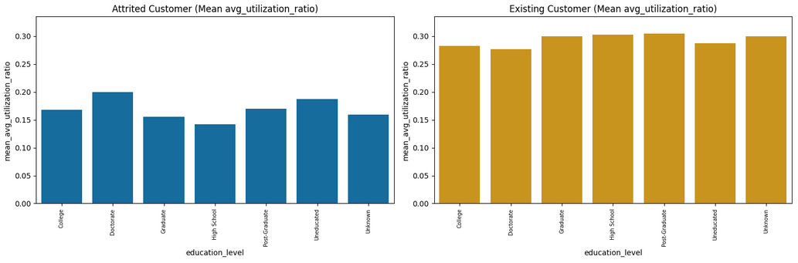
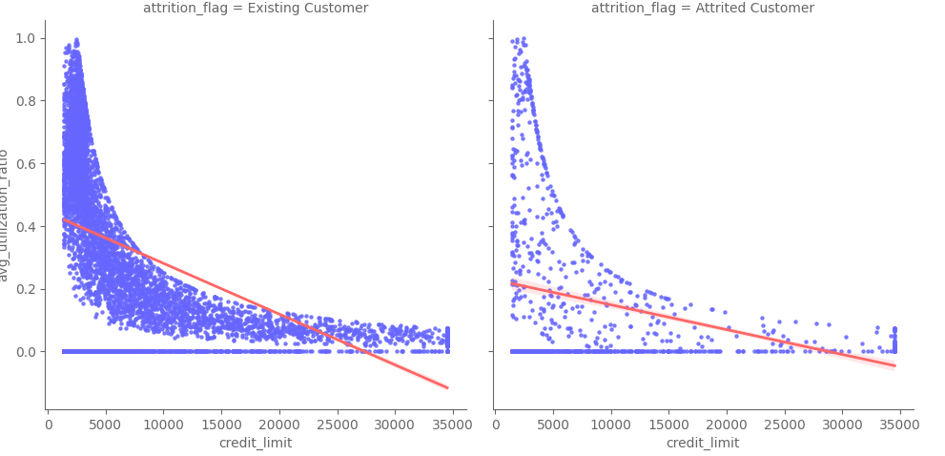
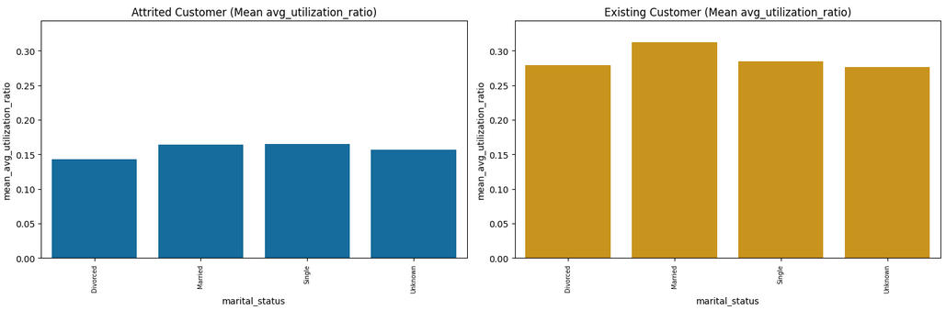
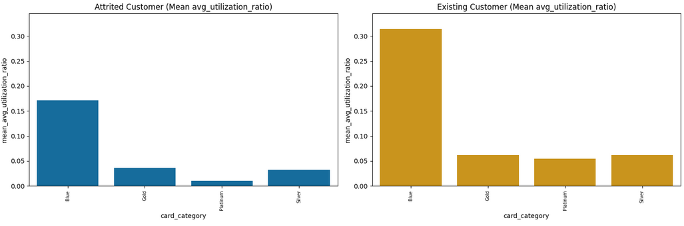
Cnc 1: Customers with lower utilization ratios have higher churn rates
Customers with lower avg. utilization ratios are more likely to churn (attrited 0.16% vs. existing 0.30%)
This is consistent across all dimensions
Customers with a lower credit limit are using the credit card les.

Slide 6
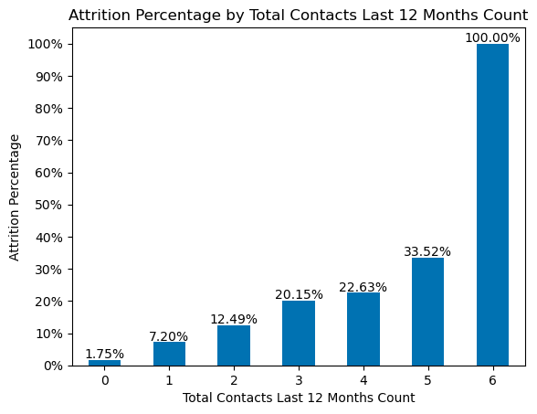
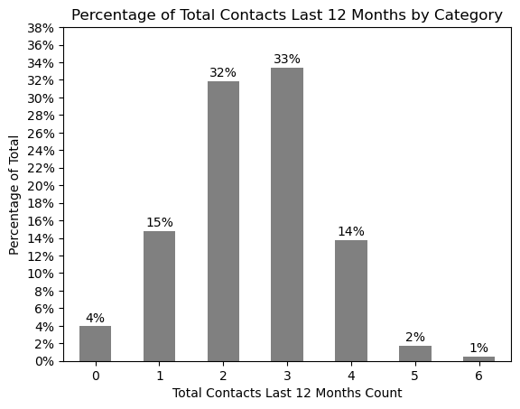
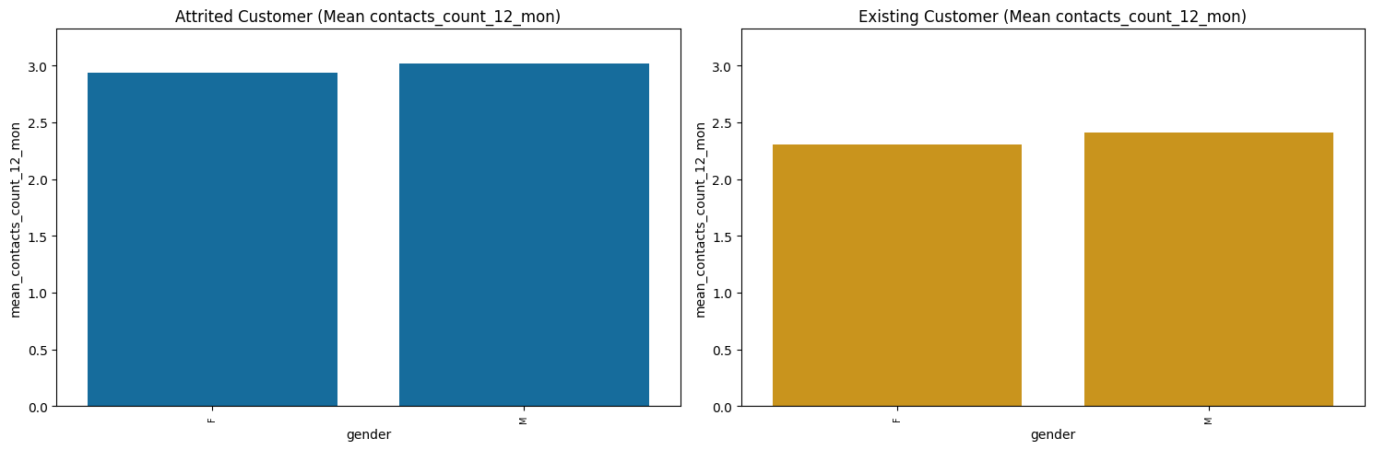
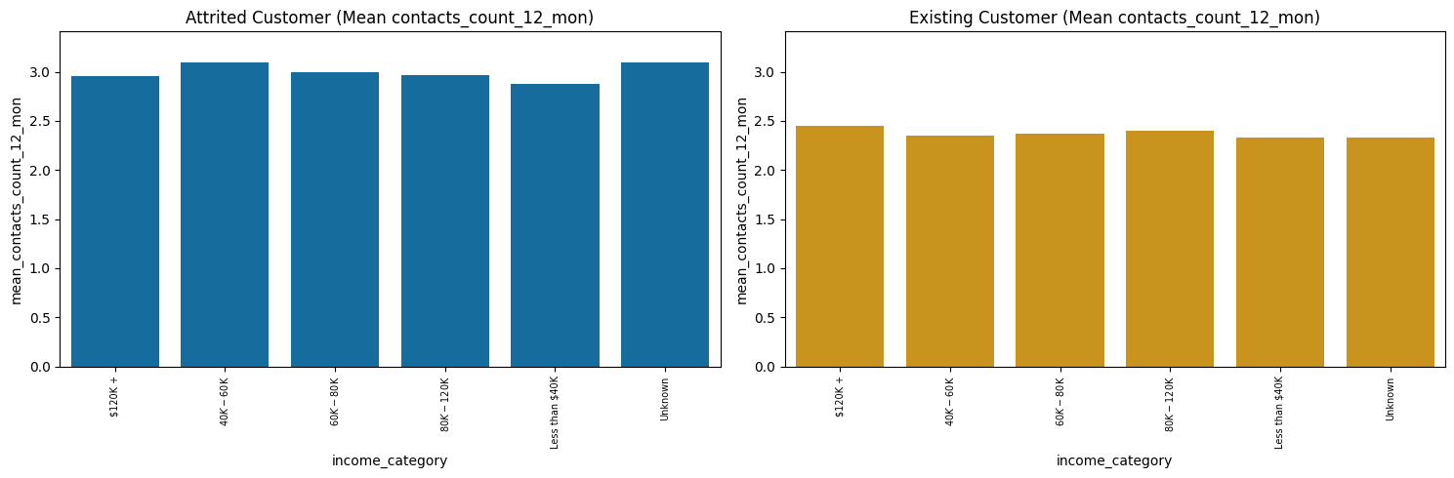
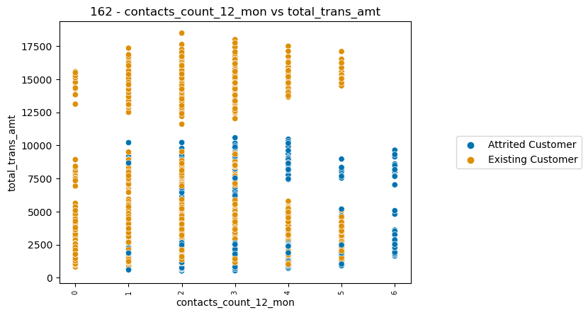
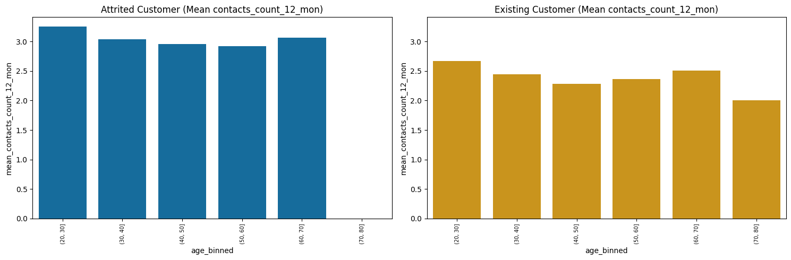
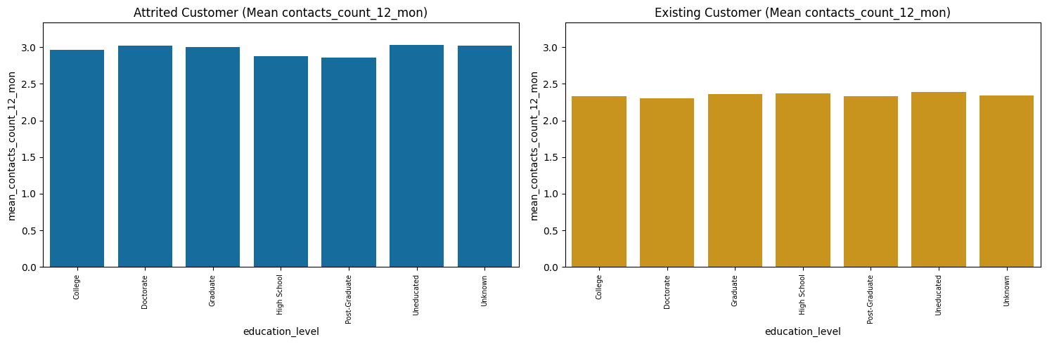
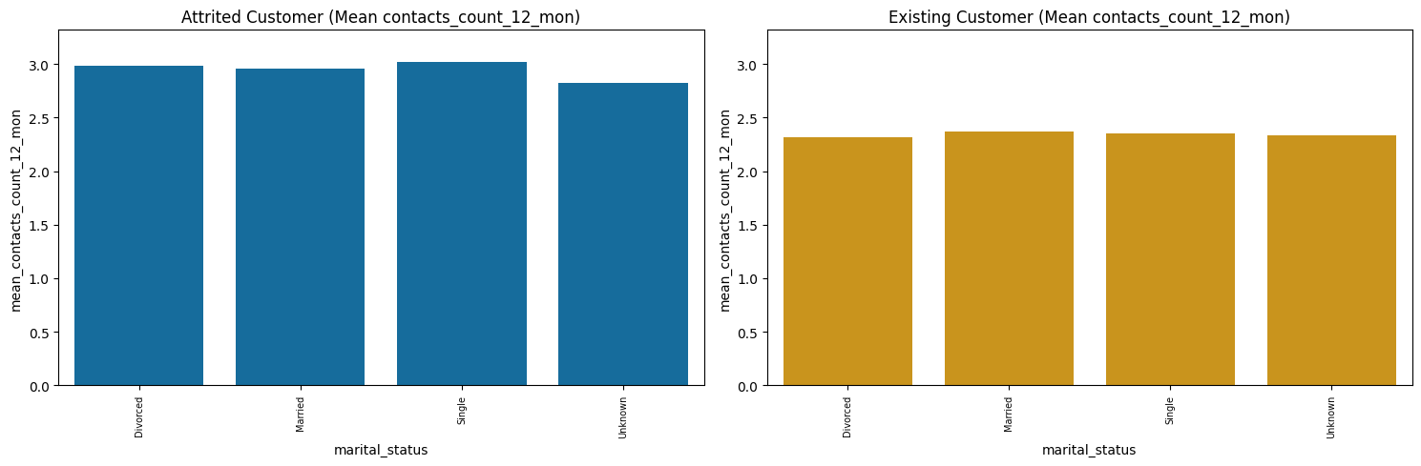
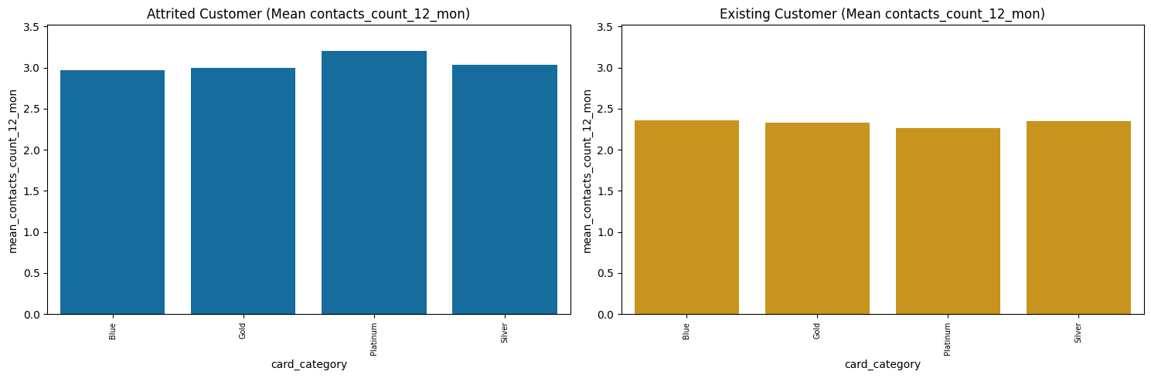
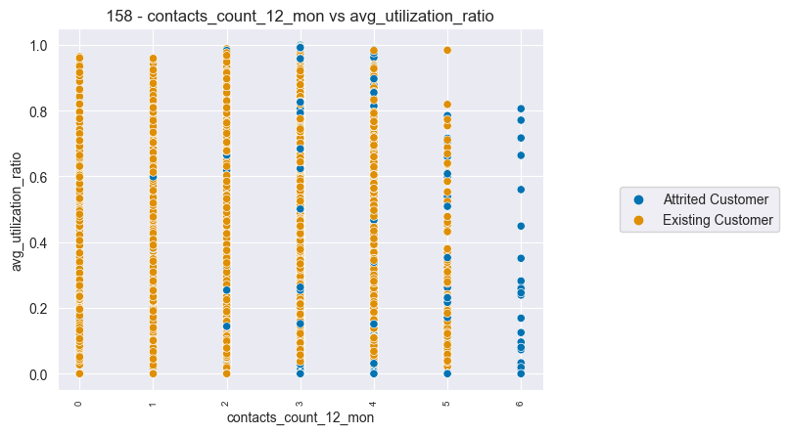
Cnc 2: Customers who were contacted less have lower churn rates.
Avg. contact count Attrited 2.97 vs. Existing Customer 2.36 (consistent across demographic info).
Churn rate increases for each increase in contact (1x 4% vs. 6x 100%).
3+ contacts result in churn rate being bigger than avg. total churn rate.
Attrited Customer
Existing Customer

Slide 7
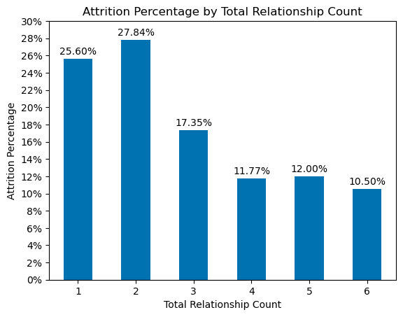
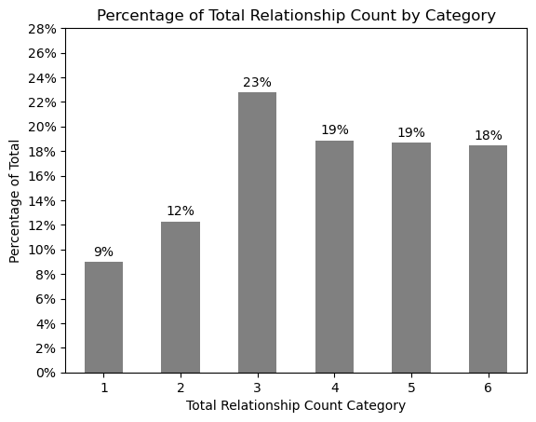
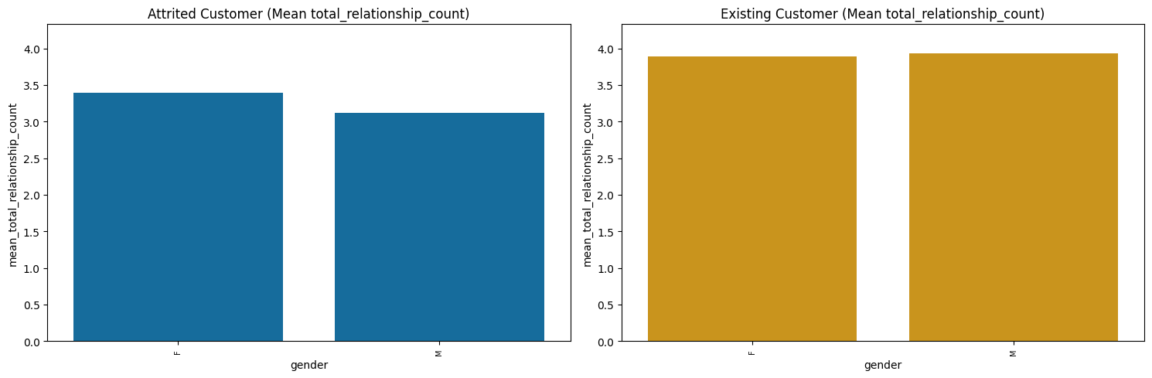
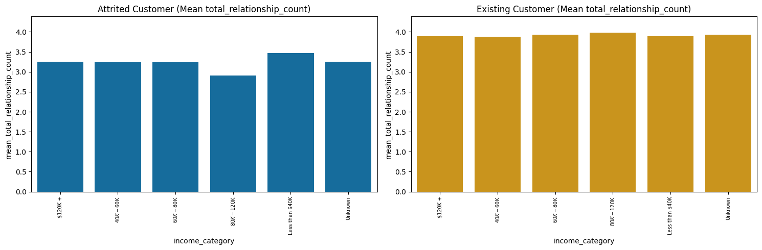
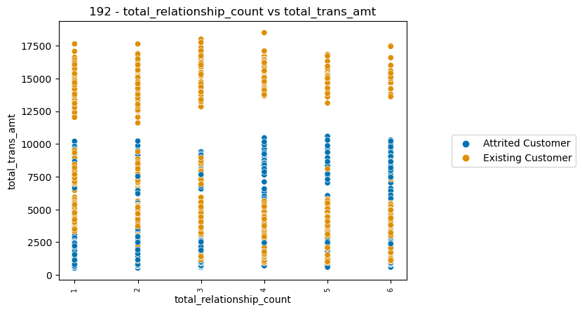
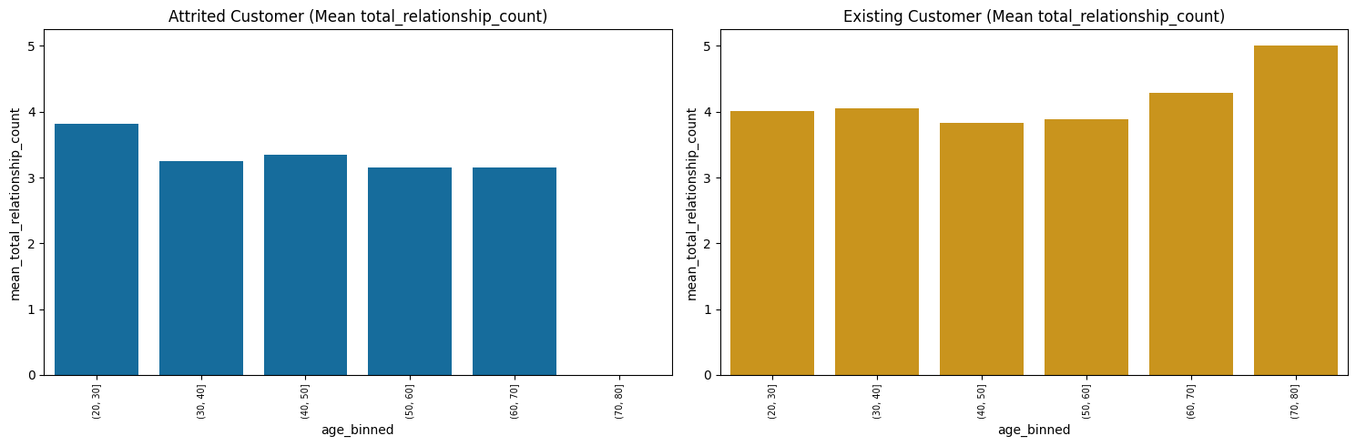
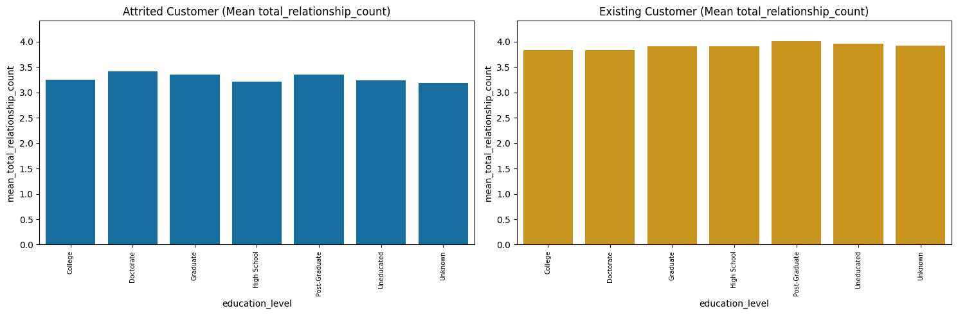
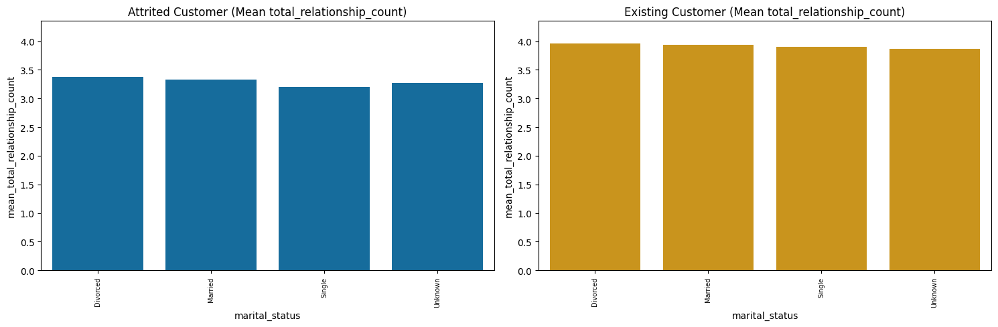
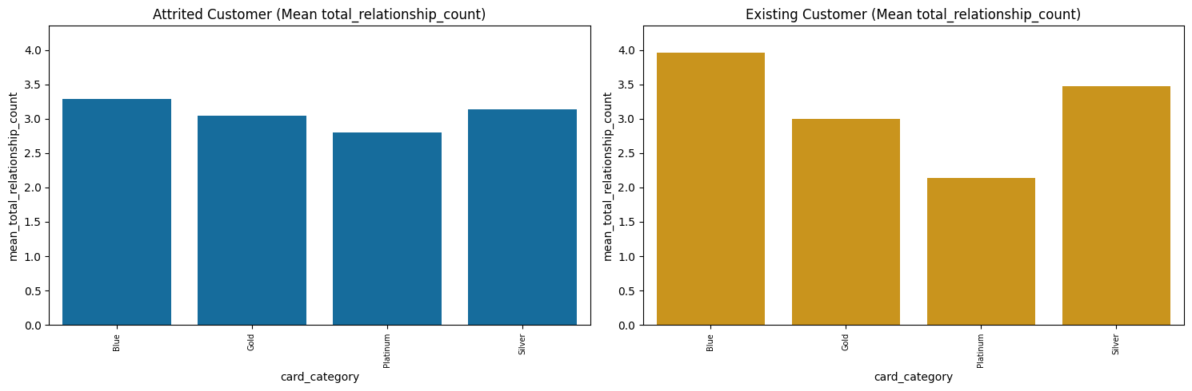
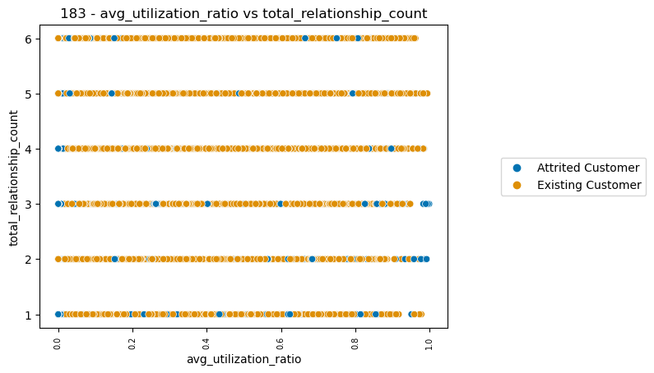
Cnc 3: Customers with more bank products have lower churn rates.
Avg. product usage Attrited 3.28 vs. Existing Customer 3.91 (consistent across demographic info).
Churn rate falls substantially for customers with 3+ banks products.
Customers using only 1 or 2 products represent smallest groups.
Attrited Customer
Existing Customer

Slide 8
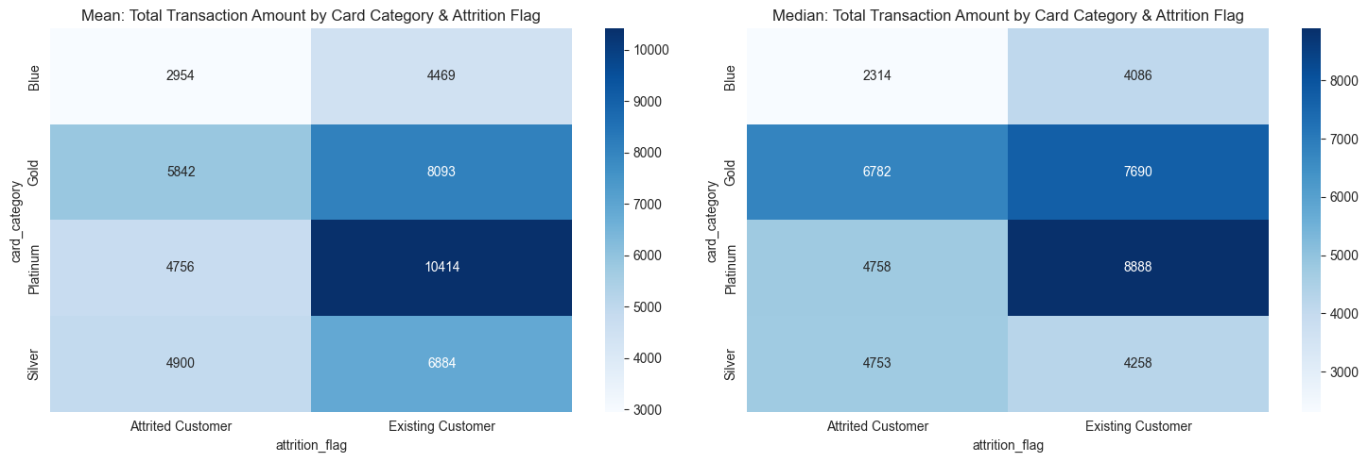
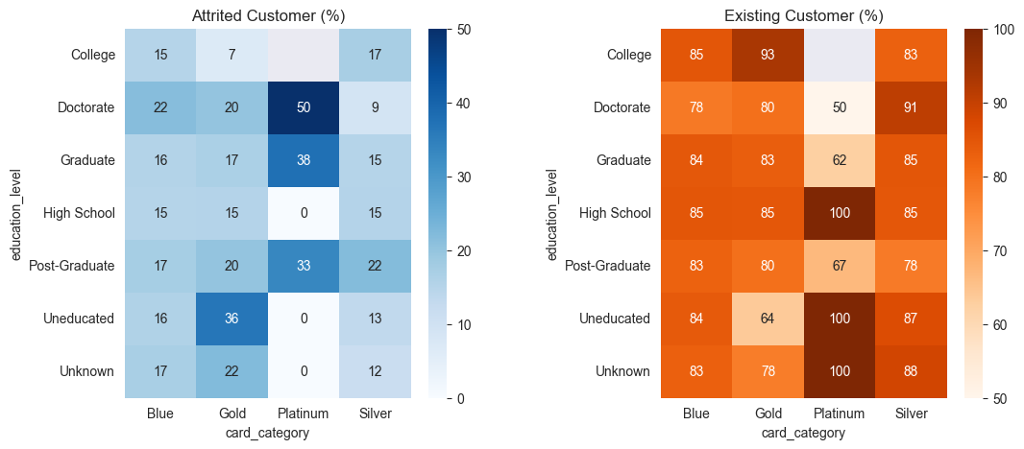
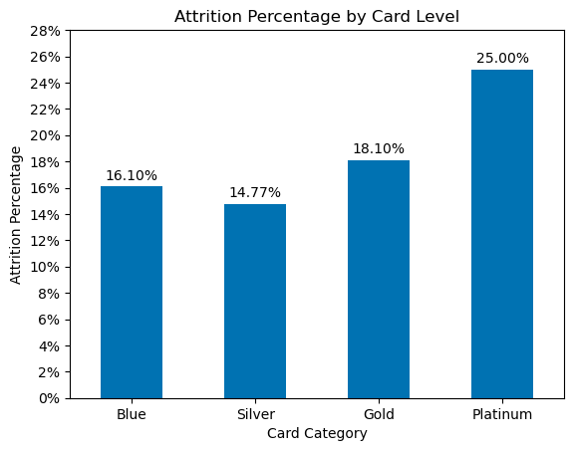
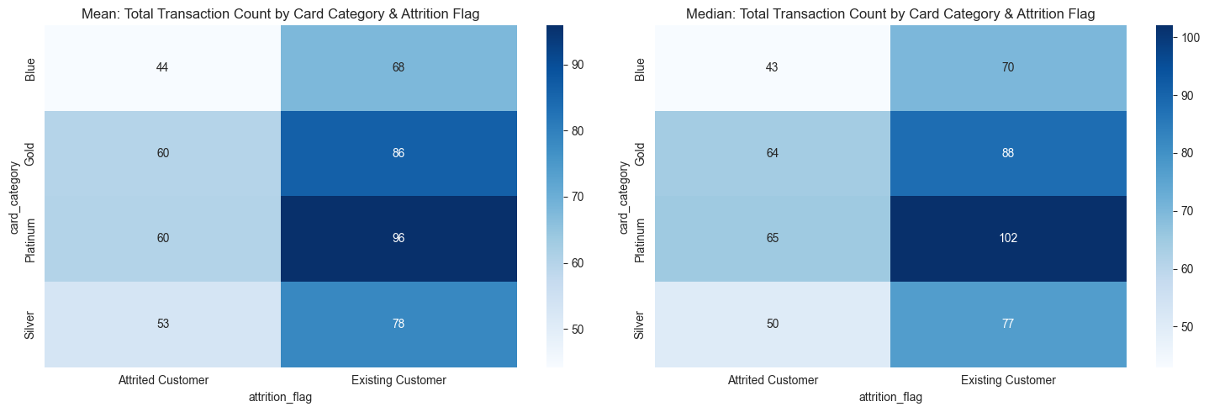
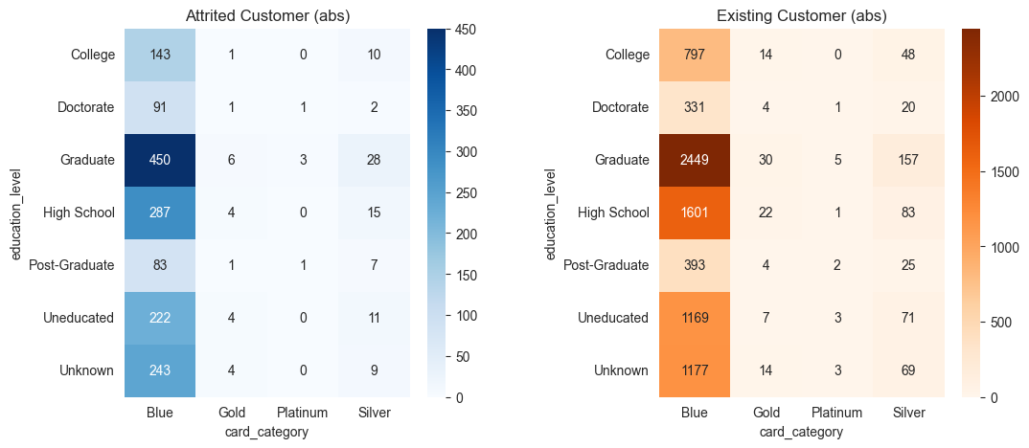
Cnc 4: Higher card categories have higher churn rates.
Highest status cards have highest churn rates (Gold 18% & Platinum 25%).
Highest status cards have higher average of transaction amounts & counts.
Caution: Gold 1.1% & Platinum 0.2% of all customers.

Slide 9
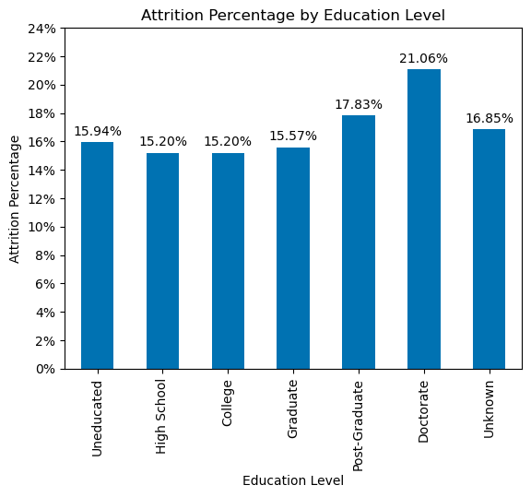
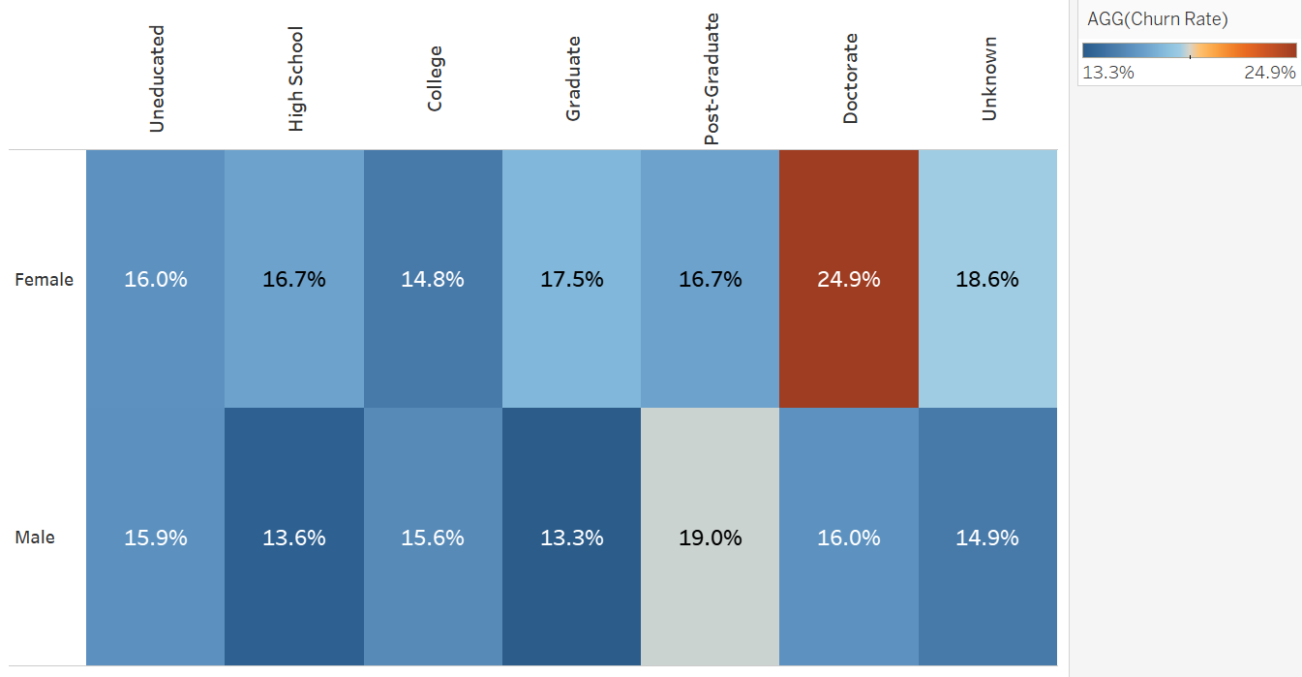
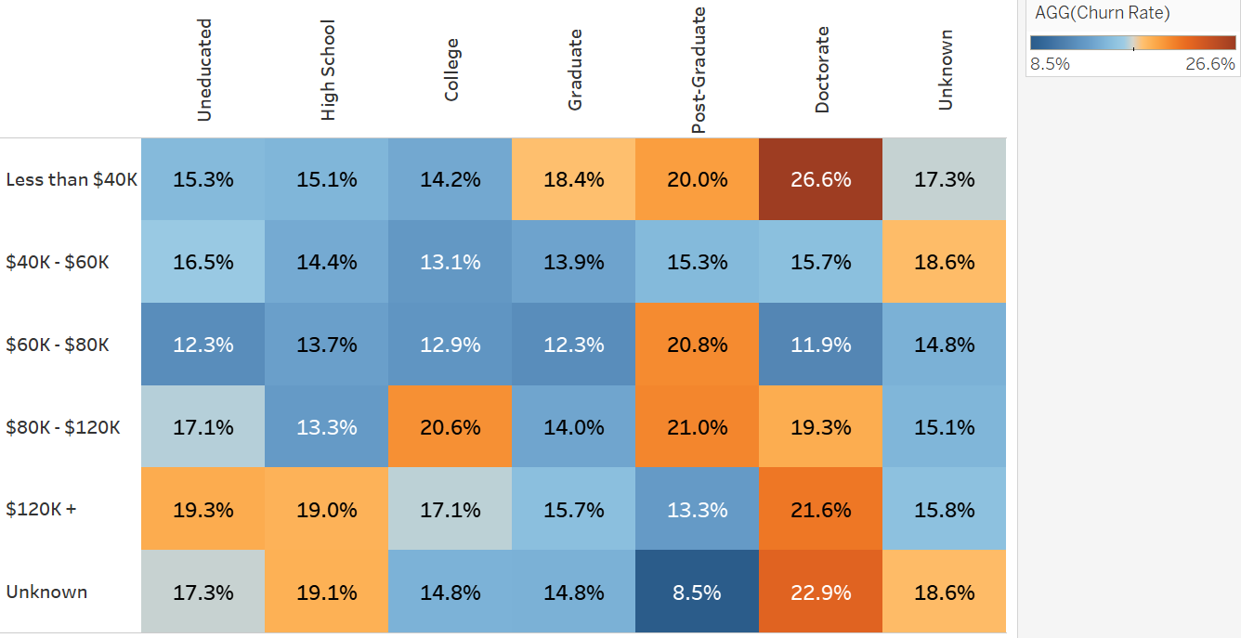
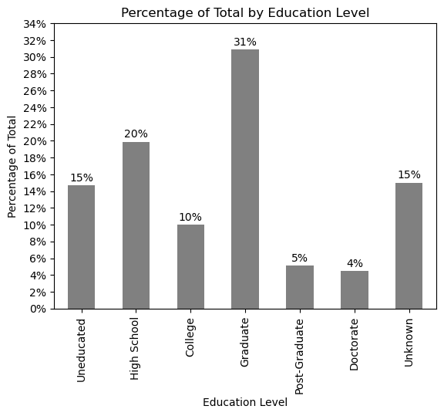


Cnc 5: Highest education levels have highest churn rates.
Churn rate increases for customers with highest education.
Groups represent ca. 10% of all customers.
Deeper analysis across demographics gives no clear additional insight.

Slide 10
Recommendations based on the given data only.*
1. Average utilization ratio:
Increase marketing & promotions to nudge more usage.
Increase credit limit for churning customers.
Attention: Default analysis required!
4. Card category:
Conduct deeper analysis of card features & costs of different card categories (e.g. (un)used features, fees, interest rates, loyalty programs).
2. Contacts count last 12 months:
Analyze means of contact (e.g. telephone, email, personal etc.).
Analyze reasons for contacting clients.
5. Education level:
Deeper analysis of acquisition costs vs. potential profit & features used across various education levels.
3. Total relationship count:
Analyze type of products existing vs. attrited customers.
Increase marketing efforts & combine products with credit card service.
6. Analysis external factors:
Competition (e.g. offerings, new entrants)
Macroeconomic environment (e.g. interest rates, unemployment).
*!! Correlation does not mean causation !!

